Slide 1
Reading for Pleasure
Koishykulova ZH
A teacher of English Language

Slide 2
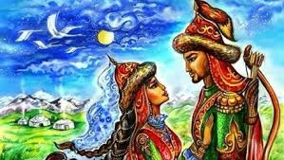

Slide 3
The theme of the story
Kozy-Korpesh and Bayan-Sulu

Slide 4
Lesson objectives
read with some support a limited range of short fiction and non-fiction texts
use with some support appropriate layout at text level for a limited range of written genres on familiar general topics and some curricular topics

Slide 5
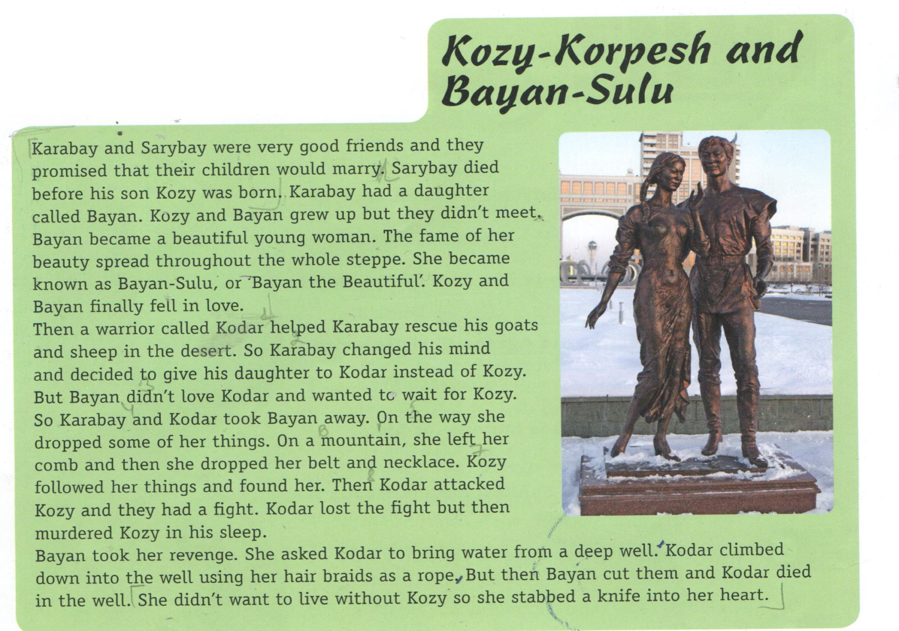

Slide 6
Topical vocabulary
warrior [‘wɔriә] - жауынгер
comb [‘koum] - тарақ
belt [belt] - белдік
necklace [‘neklis] - алқа
braids [‘breid] - бұрым
rope [‘roup] – арқан, жіп
to revenge [‘rivәndʒ] – кек алу, өш алу
to rescue [‘reskju:] – құтқару, жәрдем беру
to drop [drɔp] - тастау
to climb [‘klaimb] – өрмелеу, көтерілу

Slide 7
Exercise 2 p.106 - read the text and write true or false.
1. Bayan’s father was- Karabay. T/F
2. Kozy and Bayan met when they were young. T/F
3. Kodar was a farmer. T/F
4. Karabay decided to give Bayan to Kozy. T/F
5. Bayan didn’t love Kodar . T/F
6. Kozy followed Bayan but he didn’t find her. T/F
7. Kodar died in a river. T/F
8. Bayan didn’t want to live without Kozy. T/F

Slide 8
Exercise 3 p.106 BUILD YOUR VOCABULARY. Find this words in the text. Match the words 1-5 with the definitions a-e
1 comb a we wear it around our waist
2 knife b we wear it around our neck
3 belt c we use it to tidy our hair
4 braid d we wear it in our hair
5 necklace e we use it to cut something

Slide 9
You will be praised with a star if you achieve 6 correct answers out of 8

Slide 10
Assessment criteria
Student answers to questions correctly
Student justifies his/her answers by showing stars

Slide 11
Teacher asks learners:
What have you learnt today?
What was the most difficult during the writing task?

Slide 12
Your homework: Ex.4 at p.106 Ask and answer the questions:
Does this story have a happy ending? Why/Why not?
Who is your favourite character in the story? Why?
What other famous love stories do you know?

Slide 13
GOOD BUY!

